Slide 1

Data-Driven Analysis of Traffic Crashes in Chicago
DATS 6501: Data Science Capstone
Final Presentation
April 24, 2024
Kentaro Osawa, Bharat Premnath

Slide 2
Introduction
Background
In the world, approximately 1.19 million people die and 20 – 50 million people suffer non-fatal injuries from road traffic crashes each year. [1]
Problem Statement
In the U.S., about 6 million traffic crashes happen each year [2], leading to human suffering as well as economic losses.
About 40K people die from traffic crashes each year. [3]
Traffic crashes cost American society $340 billion in 2019. [4]
Project Scope
Finding major factors in the severity of traffic crashes by Developing ML models
Estimate the probability of the number of traffic crash in several community areas in Chicago by Developing Generalized Linear Model (GLM)

Slide 3
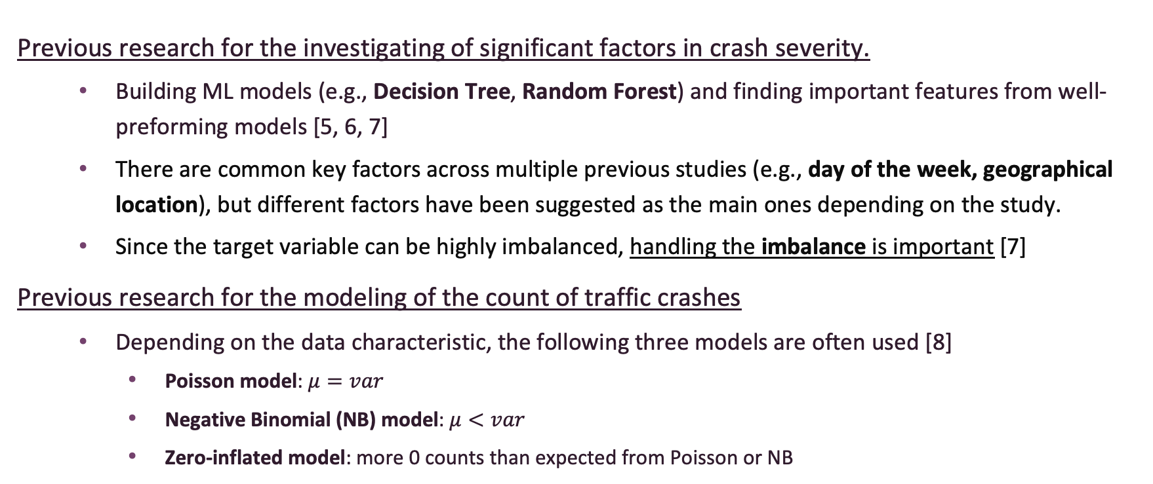
Literature Review
Previous research for the investigating of significant factors in crash severity.
Building ML models (e.g., Decision Tree, Random Forest) and finding important features from well-preforming models [5, 6, 7]
There are common key factors across multiple previous studies (e.g., day of the week, geographical location), but different factors have been suggested as the main ones depending on the study.
Since the target variable can be highly imbalanced, handling the imbalance is important [7]
Previous research for the modeling of the count of traffic crashes
Depending on the data characteristic, the following three models are often used [8]
Poisson model: $μ=var$
Negative Binomial (NB) model: $μ<var$
Zero-inflated model: more 0 counts than expected from Poisson or NB

Slide 4
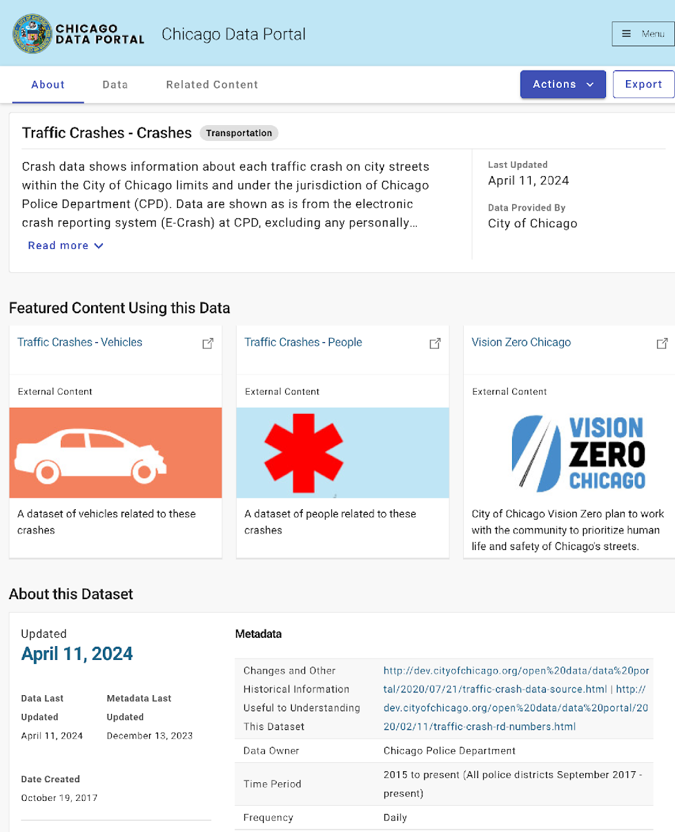
Methodology (1)
Chicago Data Portal [9]
Data Collection
dataset is acquired from Chicago Data Portal [9]
The dataset is updated daily
Data Description
799,526 observations (2015 to Jan 22, 2024)
48 features
17 numerical features (e.g., # of total injuries, # of fatalities, longitude, latitude)
31 categorical features (e.g., day of week, weather condition, lighting condition)

Slide 5
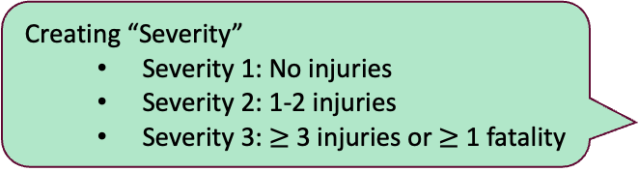
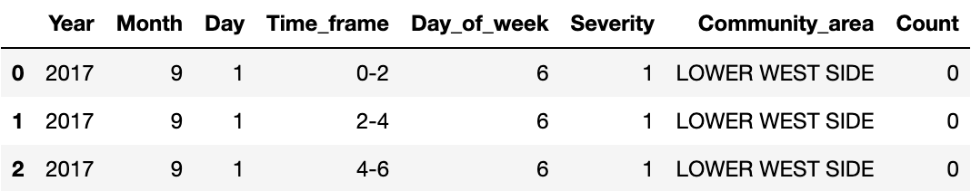
Methodology (2)
1. Dropping features with MV > 50%
2. Dropping rows with MV
Dropping Irrelevant Features
Handling Missing Value (MV)
- Creating “Severity”
- Creating “Community area”
Feature Engineering
Each row is # of crashes for each type of Severity in each community area in 2 hours interval.
Standardizing
Aggregation
- Oversampling: SMOTE
- Undersampling:
Random Under Sampling
Handling Class Imbalance
- 4 models:
Decision Tree,
Random Forest,
CatBoost, FNN
- Metric: F1 score (macro)
- 3 models:
Poisson,
Negative Binomial,
Zero-inflated model
- Metric: AIC, BIC
Developing Models
Developing Models

Slide 6
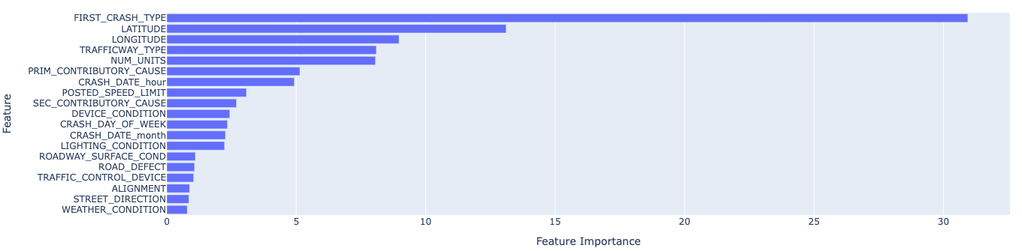
Results & Analysis – Classification(1)
Ensemble models showed better results
We focused on F1 score because of the class imbalance
CatBoost trained from the undersampled data was the best
ref. The best model’s F1 score in previous study: 0.44 [6]
“First Crash Type” and location (“Latitude” and “Longitude”) have high feature importance
Table 1: Results of models trained on undersampled data
 | CatBoost | RF | DT | FNN
Accuracy | 0.876 | 0.698 | 0.585 | 0.691
Precision | 0.445 | 0.567 | 0.557 | 0.452
Recall | 0.613 | 0.440 | 0.421 | 0.562
F1 | 0.480 | 0.427 | 0.381 | 0.420
Table 2: Results of models trained on oversampled data
 | CatBoost | RF | DT | FNN
Accuracy | 0.811 | 0.834 | 0.708 | 0.693
Precision | 0.461 | 0.449 | 0.464 | 0.409
Recall | 0.447 | 0.462 | 0.404 | 0.477
F1 | 0.452 | 0.455 | 0.408 | 0.409
Feature importance of the best model (CatBoost model)

Slide 7
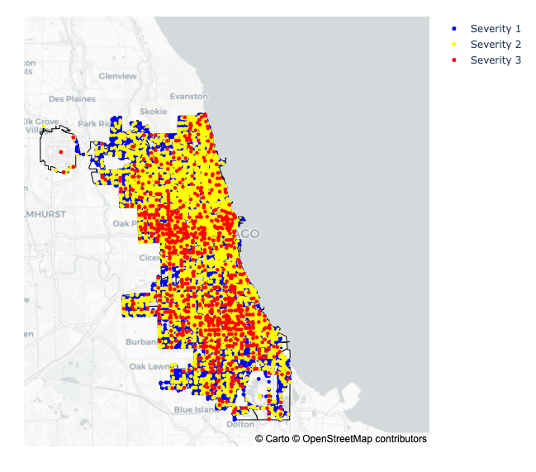
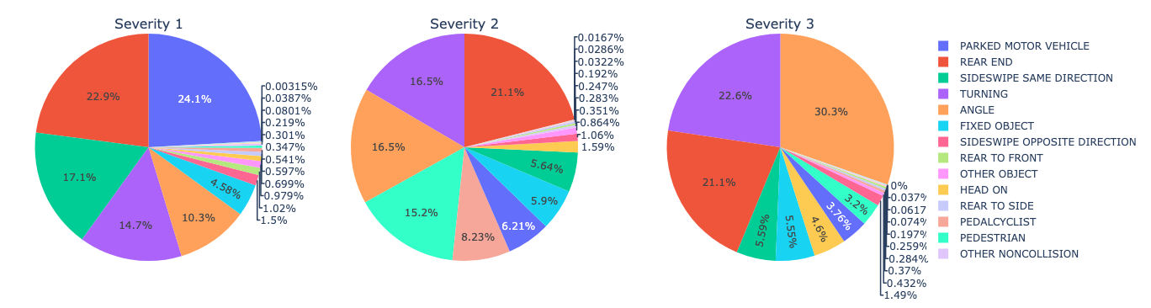
Results & Analysis – Classification(2)
The most frequent “First Crash Type” differs among Severities:
Severity 1: “Parked Motor Vehicle”
Severity 2: “Rear End”
Severity 3: “Angle” (Side collision)
Severity 3 crashes tend to be more localized than the others
Figure 2: Geographical Distribution of Traffic Crashes in 2023
Figure 1: Pie Charts of “First Crash Type”

Slide 8
Results & Analysis – GLM
We focused on 5 community areas, which account for 20% of the traffic crashes in Chicago
We compared nested models (see Table 1) for Poisson, NB, and Zero-Inflated models
NB full model was the best based on both AIC and BIC
Table 1: Independent variables for each nested model
Table 2: AIC and BIC of each model
 | Const | Month | Timeframe | Day of Week | Severity | Community Area
1 (full model) | ○ | ○ | ○ | ○ | ○ | ○
2 | ○ | × | ○ | ○ | ○ | ○
3 | ○ | ○ | × | ○ | ○ | ○
4 | ○ | ○ | ○ | × | ○ | ○
5 | ○ | × | × | ○ | ○ | ○
6 | ○ | × | ○ | × | ○ | ○
7 | ○ | ○ | × | × | ○ | ○
8 | ○ | × | × | × | ○ | ○
 | Poisson |  | NB |  | Zero-Inflated
 | AIC | BIC | AIC | BIC | AIC | BIC
1 (full model) | 459117 | 459500 | 456279 | 456662 | 457517 | 457900
2 | 459800 | 460062 | 456874 | 457137 | 458128 | 458391
3 | 493646 | 493909 | 485544 | 485806 | 485145 | 485408
4 | 460470 | 460787 | 457284 | 457602 | 458612 | 458930
5 | 494329 | 494471 | 486152 | 486294 | 485699 | 485842
6 | 461153 | 461350 | 457879 | 458076 | 459216 | 459413
7 | 494999 | 495196 | 486679 | 486876 | 486268 | 486465
8 | 495681 | 495759 | 487286 | 487363 | 486815 | 486891

Slide 9
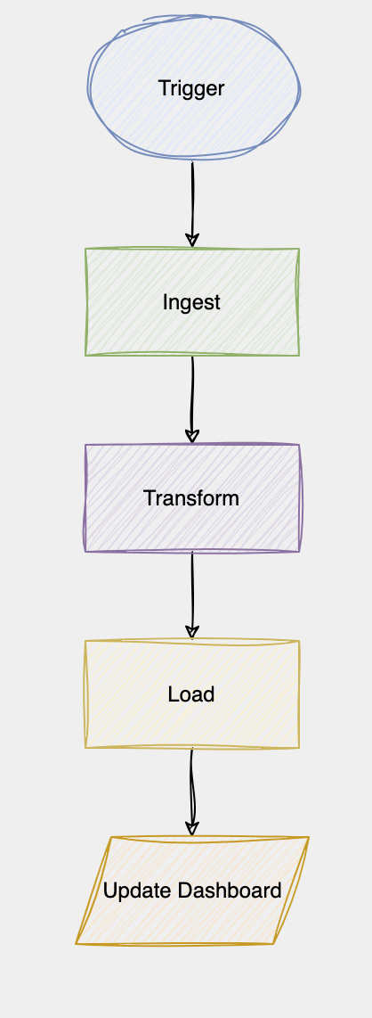
Pipeline Design
Trigger : Initiate the pipeline
Ingest : Fetch data by polling the API
Transform : Prepare the data for consumption
Load : Dump the transformed data
Update dashboard : Update the dashboard with transformed data

Slide 10
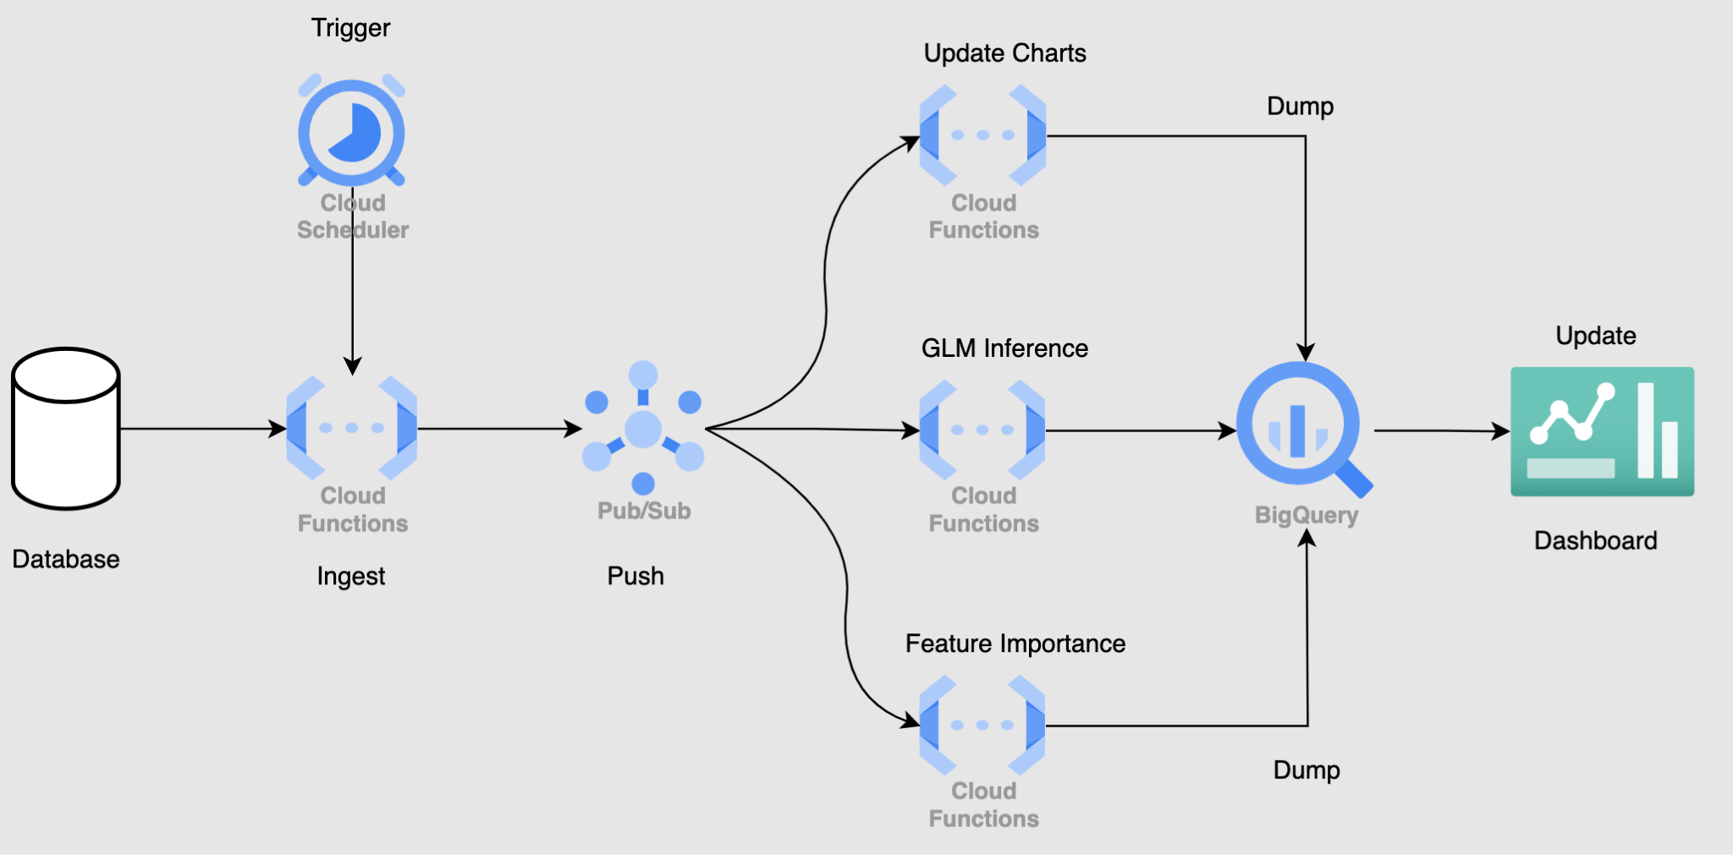
Pipeline Implementation in GCP

Slide 11
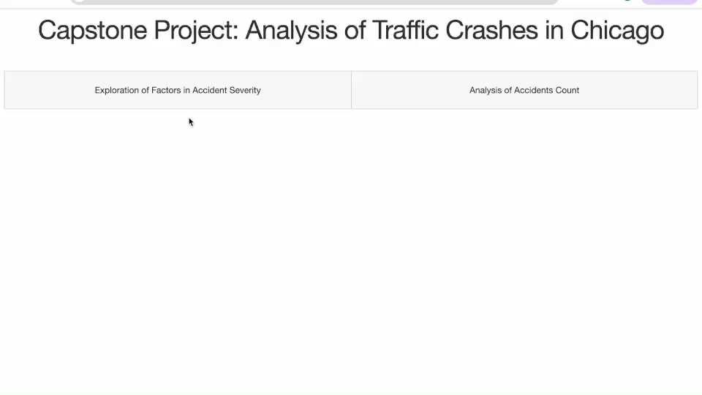
Dashboard - Demo
Our Dashboard URL: https://dashapp-wnihzixt4q-uc.a.run.app/

Slide 12
Conclusion - Summary
We developed ML models for predicting Severity level and found significant features in the best model: “First Crash Type”, “Latitude”, “Longitude”
Warnings to drivers may be effective, such as “Be cautious at scenes where side collisions are more likely to occur, like intersections or when entering roads,” especially in areas with a high occurrence of Severity 3 crashes because the most severe crashes are localized and likely to happen when the collision type is side collision.
We estimated the probability distribution of traffic crashes using Generalized Linear Models (GLM)
We built a dashboard updated daily using Google Cloud Platform (GCP)

Slide 13
Conclusion - Limitation & Further Research
Data
We collected the data from open data (Chicago Data Portal). This is a detailed data compared to the other open data, but more features would lead to better results
Drivers’ information would be good features for the classification models
Weather information might be useful for GLMs
Model
We developed Generalized Linear Models (GLMs) to estimate crash counts in various community areas. However, smaller-scale models, such as GLMs for estimating crash counts along specific roads, would be more beneficial.

Slide 14
References
[1] WHO website (https://www.who.int/news-room/fact-sheets/detail/road-traffic-injuries)
[2] National Highway Traffic Safety Administration (NHTSA) report (https://crashstats.nhtsa.dot.gov/Api/Public/ViewPublication/813515)
[3] National Highway Traffic Safety Administration (NHTSA) report (https://crashstats.nhtsa.dot.gov/Api/Public/ViewPublication/813428)
[4] NHTSA website (https://www.nhtsa.gov/press-releases/traffic-crashes-cost-america-billions-2019)
[5] Bhuiyan, H., Ara, J., Hasib, K. M., Sourav, M. I. H., Karim, F. B., Sik-Lanyi, C., ... & Yasmin, S. (2022). Crash severity analysis and risk factors identification based on an alternate data source: a case study of developing country. Scientific reports, 12(1), 21243.
[6] Ghandour, A. J., Hammoud, H., & Al-Hajj, S. (2020). Analyzing factors associated with fatal road crashes: a machine learning approach. International journal of environmental research and public health, 17(11), 4111.
[7] Fiorentini, N., & Losa, M. (2020). Handling imbalanced data in road crash severity prediction by machine learning algorithms. Infrastructures, 5(7), 61
[8] Lord, D., Washington, S. P., & Ivan, J. N. (2005). Poisson, Poisson-gamma and zero-inflated regression models of motor vehicle crashes: balancing statistical fit and theory. Accident Analysis & Prevention, 37(1), 35-46.
[9] Chicago Data Portal (https://data.cityofchicago.org/Transportation/Traffic-Crashes-Crashes/85ca-t3if/about_data)

Slide 15
Thank you for listening!

